Slide 1
CITES Tree Species Programme –
International Closing Meeting
Project Title:
Establishment of Arboreta and Strengthening Institutional Network for the Conservation of
Aquilaria malaccensis in Peninsular Malaysia
Lau Kah Hoo, Lillian Chua Swee Lian, Muhammad Alif Azyraf Azmi, Siti Fariezza Khairi Thaw,
Lee Soon Leong, Nurul Farhanah Zakaria, Tnah Lee Hong, Ng Chin Hong,
Kevin Ng Kit Siong, Lee Chai Ting
Sheraton Imperial Hotel, Kuala Lumpur
5-7 October 2022

Slide 2
Background
The genus Aquilaria has been listed in CITES Appendix II since 2004. Of the five species known in Peninsular Malaysia, A. malaccensis is the most common and harvested species, which subsequently create a threat to its natural populations. Continued loss of adult trees eventually leads to the depletion of genetic diversity.
A strong institutional network is imperative to support towards the conservation and research activities of A. malaccensis.
Objectives
To enhance conservation activities for A. malaccensis through establishment of institutional network and arboreta.
Output 1: A network of institutions that is responsible for the conservation of A. malaccensis.
Output 2: Established arboreta of A. malaccensis in selected states.
Output 3: Dissemination and sharing of results.

Slide 3
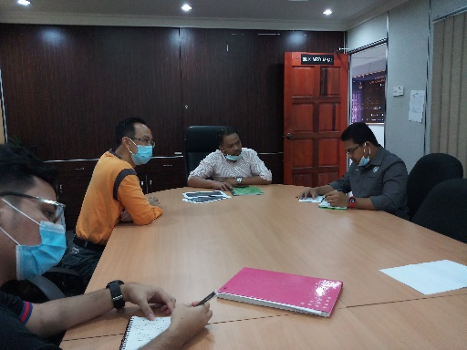
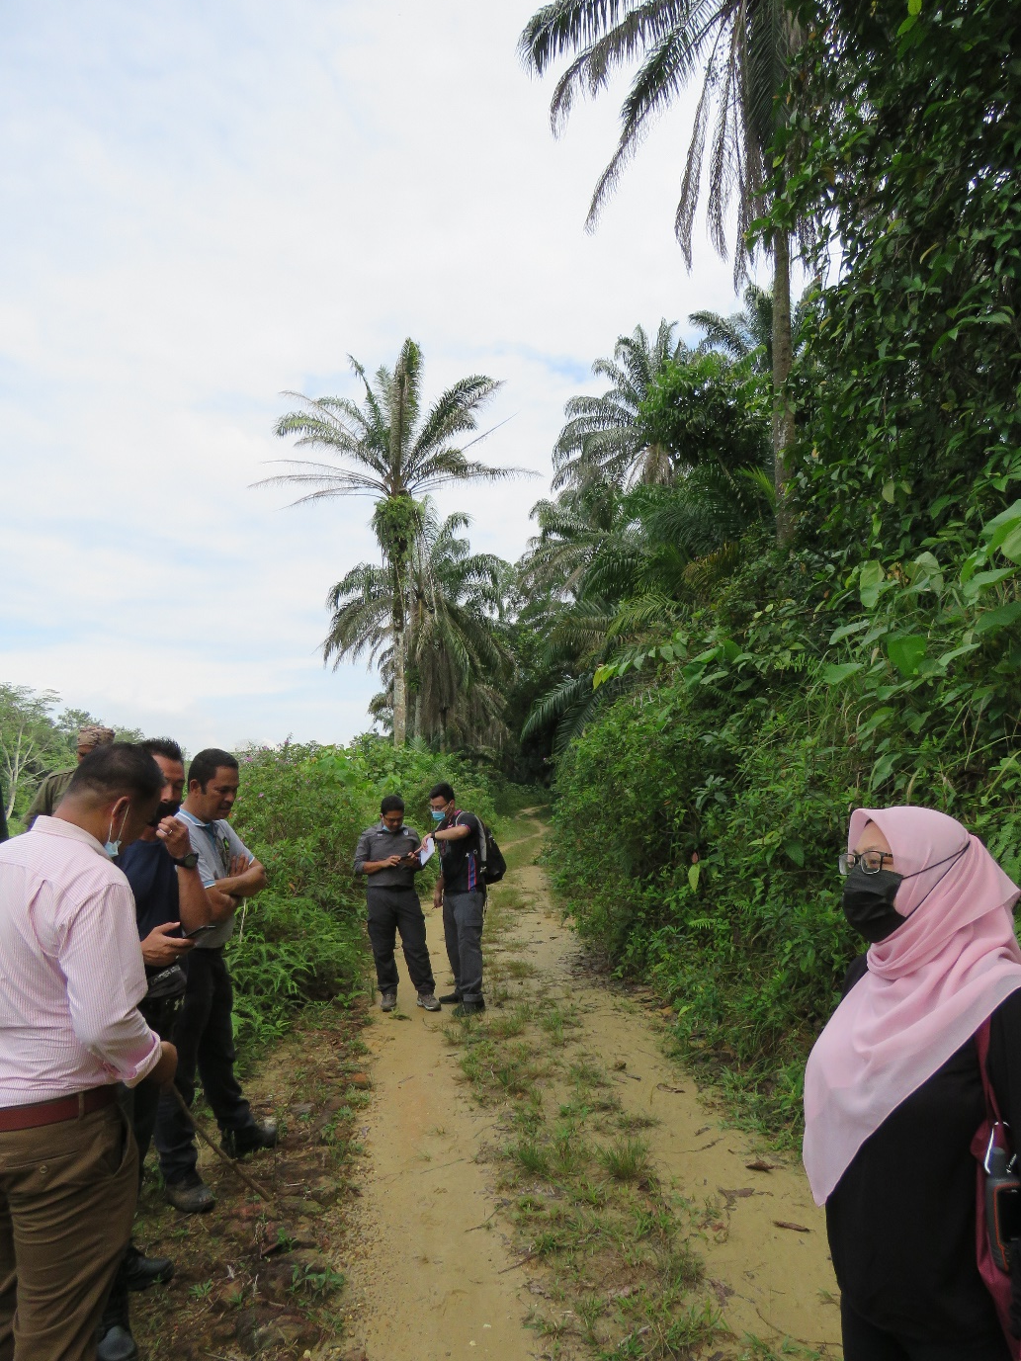
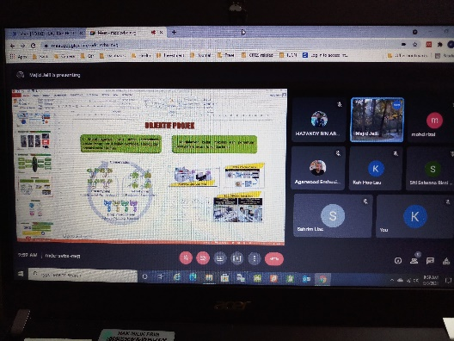
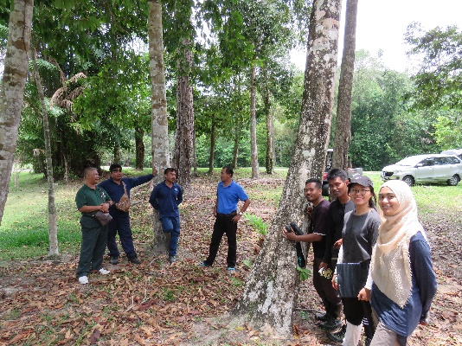
Activities to achieve Output 1
Collaborator and stakeholder meetings and fieldworks.
Data sharing with federal agency.

Slide 4
Activities to achieve Output 2
Sites visits.
Seedlings collection and nursing.
Arboreta design and establishment.
Data collection from the arboreta.

Slide 5
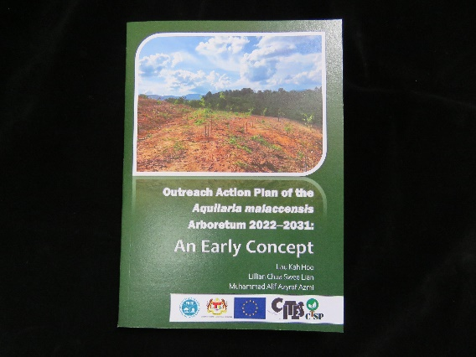
Activities to achieve Output 3
Reports submission.
Publications.
1. Two A. malaccensis arboreta established in the states of Pahang and Selangor in September 2021 and February 2022, respectively.
2. Lau, K.H., Chua, L.S.L. & Muhammad Alif, A.A. 2022. Outreach Action Plan of the Aquilaria malaccensis Arboretum 2022-2031: An Early Concept. Forest Research Institute Malaysia, Kepong.
https://cites-tsp.org/wp-content/uploads/2022/05/cites_ctsp_malaysia_Outreach_Action_Plan_Aquilaria_malaccensis_Arboretum.pdf
3. Lau, K.H. et al. 2022. Guidelines for the establishment of Aquilaria malaccensis arboretum in Peninsular Malaysia. Pp. 16.
https://cites-tsp.org/wp-content/uploads/2022/05/CITES_TSP_Guidelines_for_Aquilaria_Malaccensis_Arboretum_Establishment_c.pdf
4. Lau, K.H., Muhammad Alif A.A. & Chua, L.S.L. 2022. A report on the strengthening of networking between relevant states and federal agencies to discuss and resolve issues on the conservation and sustainability of Aquilaria malaccensis in Malaysia, including the sharing of data. Report submitted to CITES Tree Species Programme (CTSP). Pp 6.
https://cites-tsp.org/wp-content/uploads/2022/05/cites_ctsp_malaysia_Report_strengthening_network_april_2022.pdf
5. Lau, K.H., Muhammad Alif A.A., Siti Fariezza K.T. & Chua, L.S.L. 2022. Establishment of Aquilaria malaccensis arboreta in Pahang and Selangor, Peninsular Malaysia. Report submitted to CITES Tree Species Programme (CTSP). Pp 14.
https://cites-tsp.org/wp-content/uploads/2022/06/Report-on-establishment-of-Aquilaria-malaccensis-arboreta_200422-thc_Revised-thc_Final-002.pdf

Slide 6
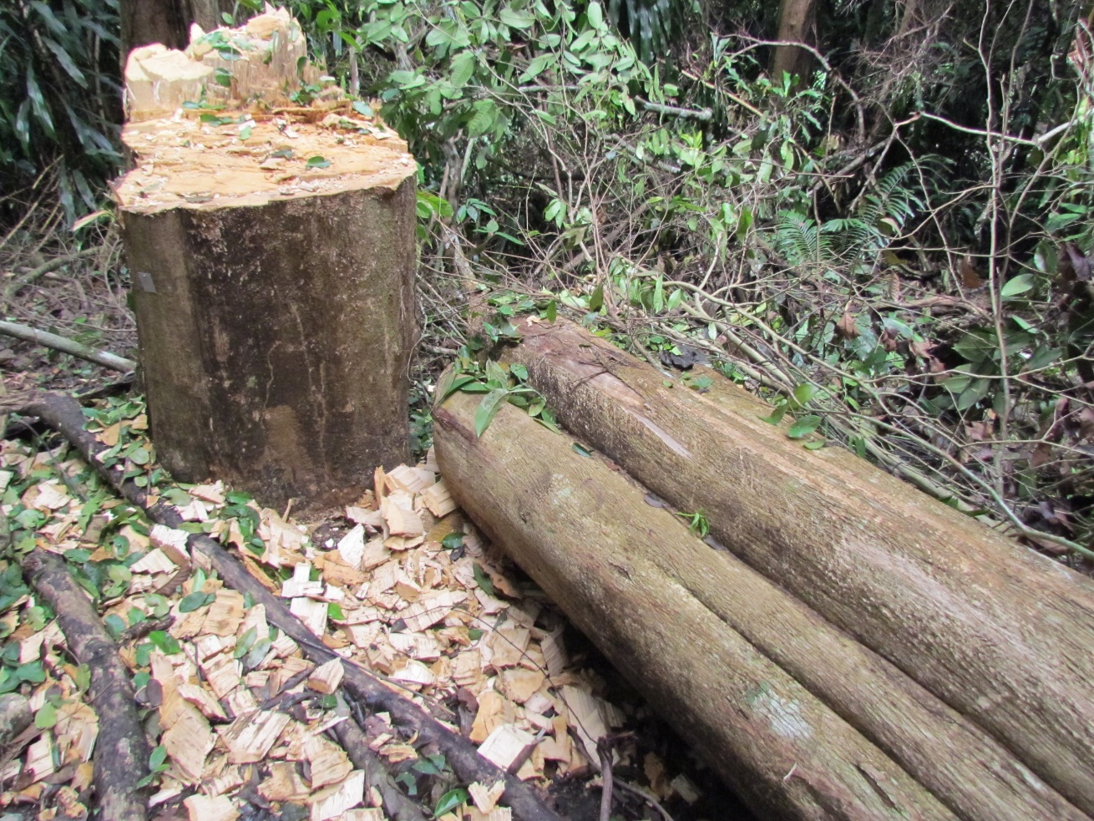
Expected outcomes
Genetic conservation of A. malaccensis is better achieved with more systematically designed and well-managed arboreta.
The establishment of arboreta is expected to lessen harvesting pressure on natural populations in the long term when sufficient research and development on trees that are able to provide planting materials which produce high quality agarwood yield become readily available.

Slide 7
Inter-governmental collaborations on the research and conservation of A. malaccensis is pivotal and had improved since then. This involved forest managers and experts from different agencies such as the Forestry Department of Peninsular Malaysia, Malaysian Timber Industry Board and University Putra Malaysia.
Institutional network
Communication improved
Data sharing transpired
Project collaboration materialised
Two A. malaccensis arboretum established
Improve chain-of custody trade for better management
Stimulate research & development activities
Lau, K.H., Muhammad Alif A.A. & Chua, L.S.L. 2022. A report on the strengthening of networking between relevant states and federal agencies to discuss and resolve issues on the conservation and sustainability of Aquilaria malaccensis in Malaysia, including the sharing of data. Report submitted to CITES Tree Species Programme (CTSP). Pp 6.
Improvement (in blue) and future expectation (in orange) after the CTSP project implementation.

Slide 8
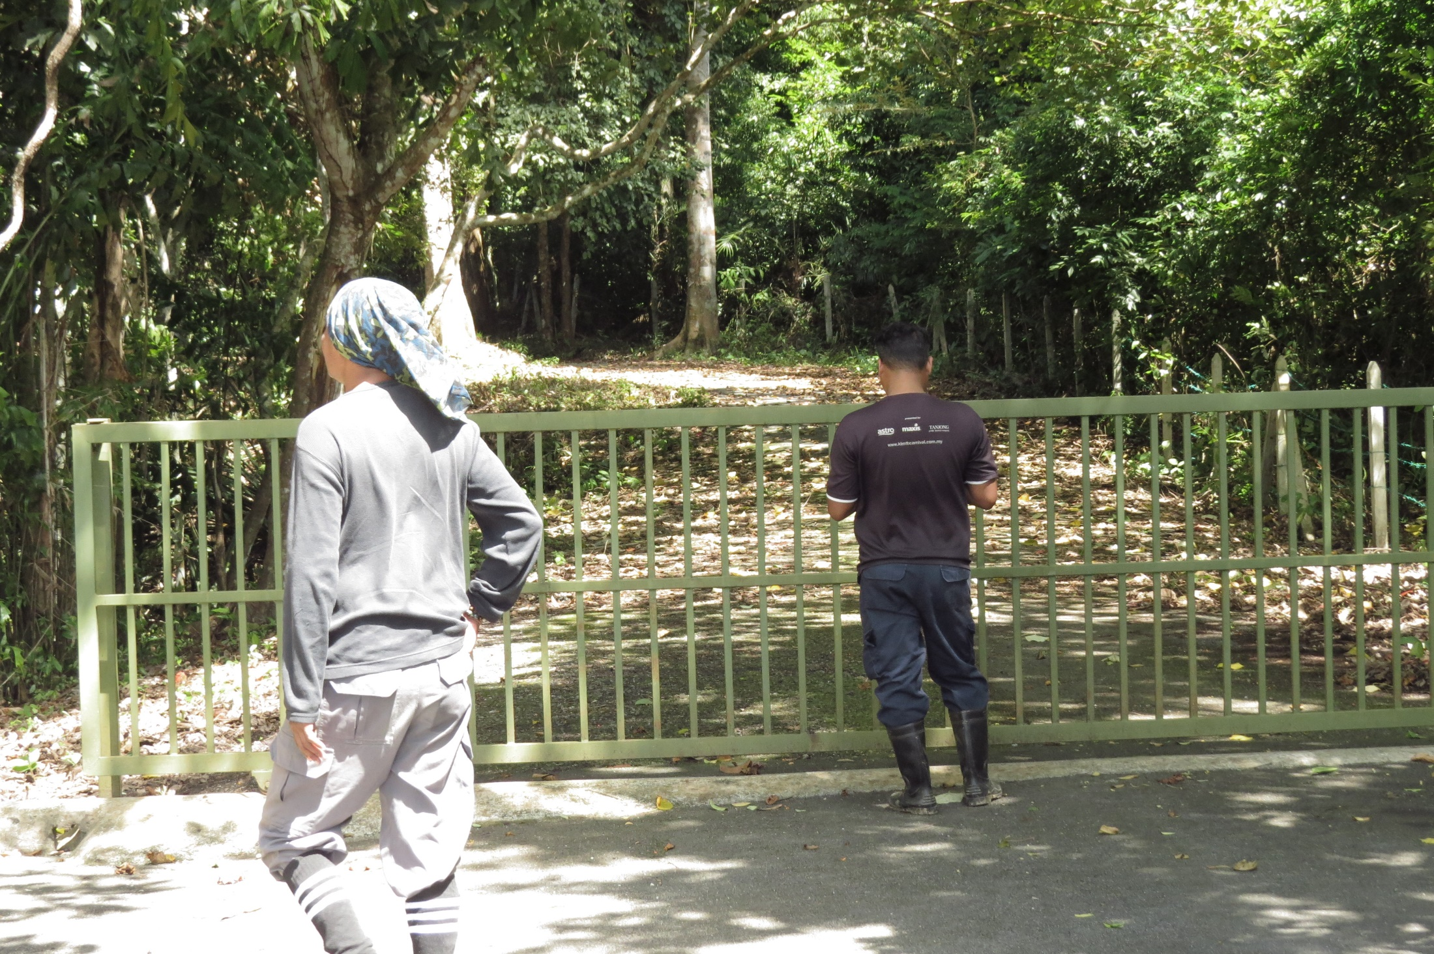
Challenges
Low availability of seedlings arising from the absence of reproductive mother trees, lack of flowering events and low germination.
Mortality of mother trees.
Change of land status and accessibility to planned sites.
The Malaysian government had imposed nationwide Movement Control Order (MCO) from March 2020 until July 2021 to curb the spread of COVID-19 – impeded planned field trips, meetings, etc.

Slide 9
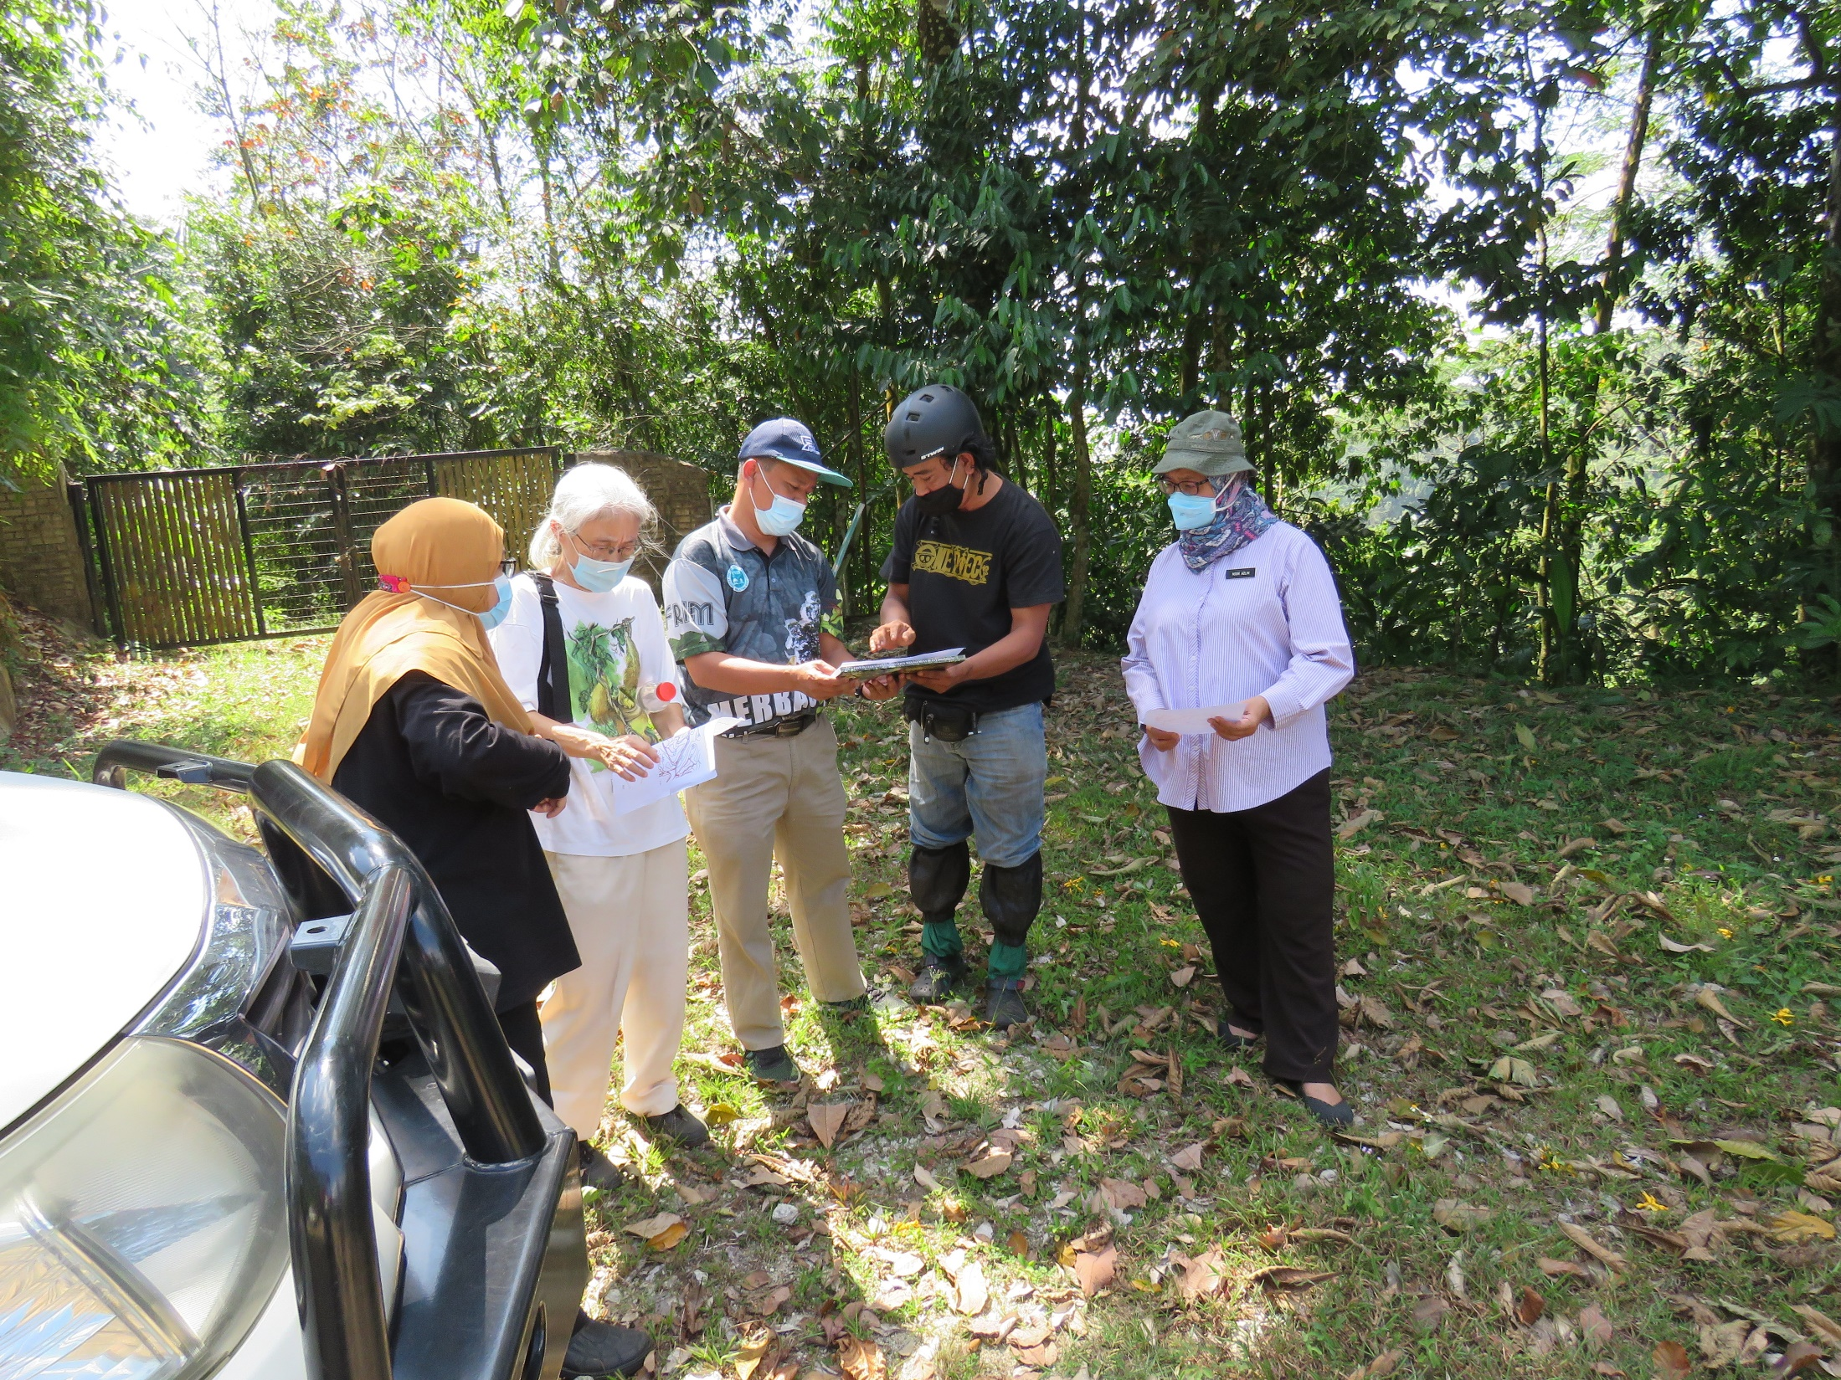
Lessons learned
Alternative or ‘backup plans’ need to be included at the planning stage.
Listing of several potential sites during initial meetings with respective land managers.
Acquire information on changes in land status as part of conservation management approach.
More dialogues should be organized to gather information on research and development from relevant stakeholders that could contribute to the conservation of A. malaccensis.

Slide 10
Way forward
Potential of exploring into genome-wide association studies.
Tree improvement and breeding programmes – potential as commodity species.
Teaching facility for tree dendrology.
Additional arboreta for better representation.

Slide 11
THANK YOU

