Slide 1
CITES Tree Species Programme (CTSP)
Central & South America and the Caribbean Region
CLOSING MEETING
Sofia Hirakuri, Coordinator
5-7 October 2022, Kuala Lumpur, Malaysia

Slide 2
CTSP Projects
Central & South America and the Caribbean Region:
Budget by Country (USD)
5 individual country projects:
Argentina
Brazil (2)
Cuba
Guatemala
1 Trinational Project: Guatemala - Nicaragua - El Salvador
1 ITTO project: Ecuador
Total: USD 1.16 million

Slide 3
CTSP Projects in Central & South America and the Caribbean Region: An Overview
Work areas:
Non-detriment Findings (NDF)
Marking & traceability
Wood Identification
Capacity-building & governance
Species coverage by country:
Cedrella sp.(Cedar) – Brazil
Dalbergia sp. – Brazil, Guatemala, Nicaragua, El Salvador
Guaiacum officinale | Guaiacum sactum (guayacán, guayacán negro, palo santo) – Cuba
Gonopterodendron sarmientoi (Palo Santo) – Argentina
Swietenia Macrophylla (Mahogany,Caoba) – Brazil, Ecuador

Slide 4
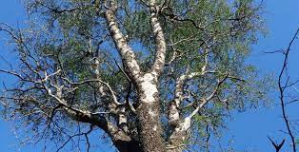
CTSP Projects in Central & South America and the Caribbean Region: Main Objectives
ARGENTINA – NDF | Gonopterodendron sarmientoi
Develop, validate and implement the National Strategic Plan for SFM of Palo Santo (Gonopterodendron sarmientoi)
Develop and update information generated in another project to increase the level of biological knowledge and improve SFM of Palo santo.
Disseminate the results of the project to the stakeholders and to the countries of the Gran Chaco Americano → Argentina (60%), Paraguay (23%), Bolivia (13%), Brazil (4%)
Gonopterodendron sarmientoi

Slide 5
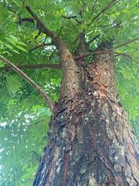
CTSP Projects in Central & South America and the Caribbean Region: Main Objectives
BRAZIL S-544 | Traceability | Dalbergia
Verify the use of NIRS technology for field identification of 20 Dalbergia species and rosewood oil to ensure that the international trade meets CITES requirements for the sustainability of the species.
BRAZIL S-608 | Traceability and monitoring| Dalbergia
Verify NIRS technology for timber monitoring to contribute to their legal, traceable, and fair trade.
Mahogany

Slide 6
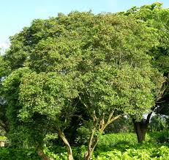
CTSP Projects in Central & South America and the Caribbean Region: Main Objectives
CUBA | Capacity-building | Guaiacum sp.
Examine the current distribution, abundance and population dynamics of Guaiacum sp. species
Obtain updated information to make a NDF and establish actions for their conservation.
Strengthen the role and cooperation between the Scientific Authorities and the authorities in charge of timber and timber products trade control .
Guaiacum sp.

Slide 7
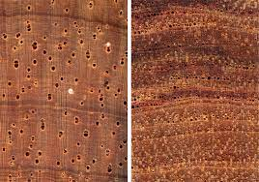
CTSP Projects in Central & South America and the Caribbean Region: Main Objectives
GUATEMALA | Wood Identification | Dalbergia sp.
Characterize 6 Dalbergia tree species from Guatemala and 5 similar species.
Molecularly characterize Dalbergia tree species from Guatemala and check taxonomic aspects related to the genus.
Accredit through the ISO 17025 Standard the identification processes of forest products and link them to the environmental legal system in Guatemala.
Increase the capacity of enforcement institutions to improve CITES implementation in Guatemala.
Dalbergia sp.

Slide 8
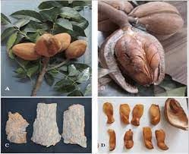
CTSP Projects in Central & South America and the Caribbean Region: Main Objectives
GUATEMALA – NICARAGUA - EL SALVADOR Trinational Project | DENP Dalbergia and Swietenia macrophylla
Create a monitoring tool for the conservation and SFM of Dalbergia sp.
Develop technical guidelines for SFM to make NDF for Dalbergia genus.
Develop technical management guidelines for production systems in plantations and agroforestry systems, using Dalbergia genus.
Develop a training / rural extension plan for promoting SFM of Dalbergia in the wild, forest plantations and agroforestry systems, to contribute to poverty reduction in rural areas.
Swietenia macrophylla

Slide 9
CTSP Projects in Central & South America and the Caribbean Region: Summary Outputs
ARGENTINA
Agreement on Inventory design specifications
2 scientific papers
TRINATIONAL (Guatemala, Nicaragua & El Salvador)
6 national workshops
Technical guide for forest nurseries, agroforestry and forest plantation (3 countries)
BRAZIL
Technical paper
Scientific papers
CUBA
ICCW indicator Framework assessment
Planting in protected areas
ECUADOR (project in progress)
GUATEMALA
Collection of herbarium botanical vouchers
Technical manual
CITES certificate resolution approval
5 reports (methodology, practices comparison)
Training students
Capacity building workshops
129 rosewood oil samples collected
NIRS discrimination model built
4 informatives on wood ID
Mahogany NIRS collected
Capacity building
Collection of xylarium samples
4 scientific papers
Technical reports
Dalbergia foliar samples collection for molecular analysis
Lab personnel training
Dalbergia DNA samples collection
Wood sample collection of 7 Dalbergia species
Regional strategy 2022-2032
Developed automated monitoring tool for conservation and SFM
Dalbergia phenological calendar report by country
Training for PSP measurement
Manual for NDF preparation
NDF for Dalbergia retusa (3 countries)
Agreement signed between PAKKIRU and the Project
MOUs with the Ceploa and Elena Andi communities
Field information collection on social and forestry aspects
Samples of Cedrela Odorata and Swietenia macrophylla collected
TFU article in preparation
Press release
Press release

Slide 10
Central & South America & the Caribbean - Conclusions
Argentina, Cuba and Tri-national projects provided NDFs of timber species, respectively (Gonopterodendron sarmientoi, Guaiacum and Dalbergia).
Guatemala and Brazil implemented projects related to identification of tree species, marking and traceability, promoting the control of legal origin of forest products.
Ecuador project support the implementation of public policy as to conservation, regulation and forest management of Swietenia macrophylla.
All project activities managed to meet the originally proposed goals and objectives, and produced satisfactory deliverables.
In sum, the main objectives of projects have been achieved, but there are some activities to be finalized by November 2022 due to the COVID-19 pandemic; as result, some activities have been delayed.
A project video (short/long versions) has been produced by all CTSP countries.

Slide 11
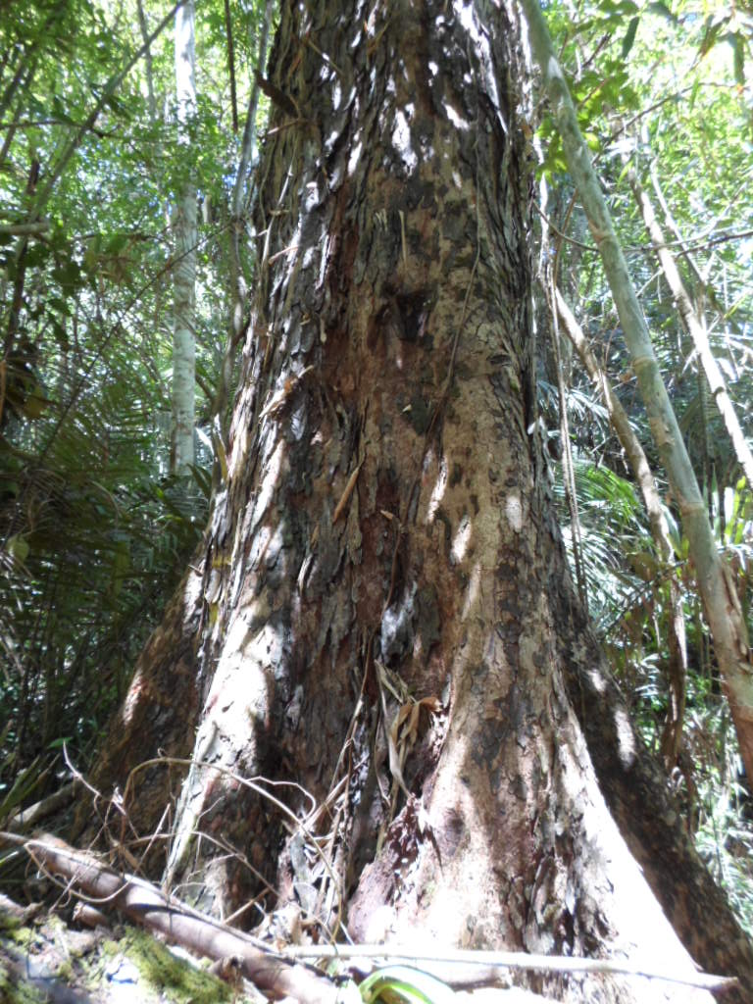
Thank you
Sofia Hirakuri
Regional Coordinator – Central & South America and the Caribbean
Contact: sofia.hirakuri@un.org
Mahogany
(Swietenia Macrophylla)

